Slide 1


DECODING INSTAGRAM'S RDF STRUCTURE AND DATA STORAGE

Slide 2
Introduction
Unveiling the Digital Tapestry: Decoding Instagram's RDF Structure and Data Storage Mechanism And Videos data storage and quality management.

Slide 3

WHAT IS RDF?
RDF (Resource Description Framework) is a standard for representing data on the web. It provides a way to describe resources and their relationships using subject- predicate-object triples.

Slide 4

RDF STRUCTURE IN INSTAGRAM
Instagram's RDF structure consists of entities such as users, posts, comments, and hashtags. These entities are interconnected through relationships like follows, likes, and mentions.

Slide 5
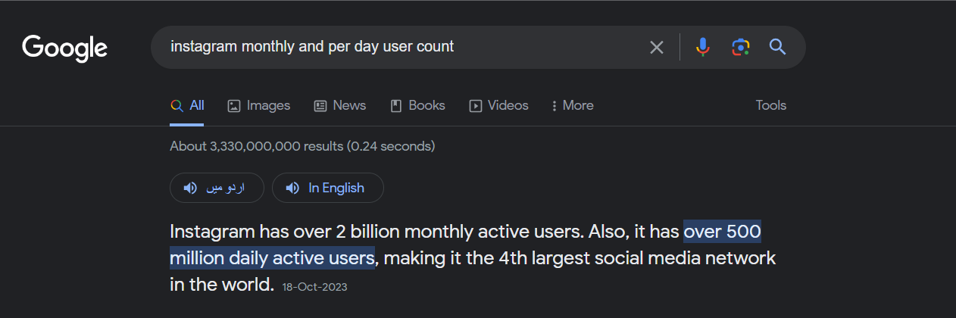
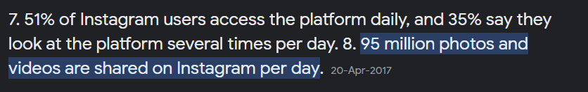
INSTGRAM USER AND NUMBER OF DAILY UPOLOADS

Slide 6
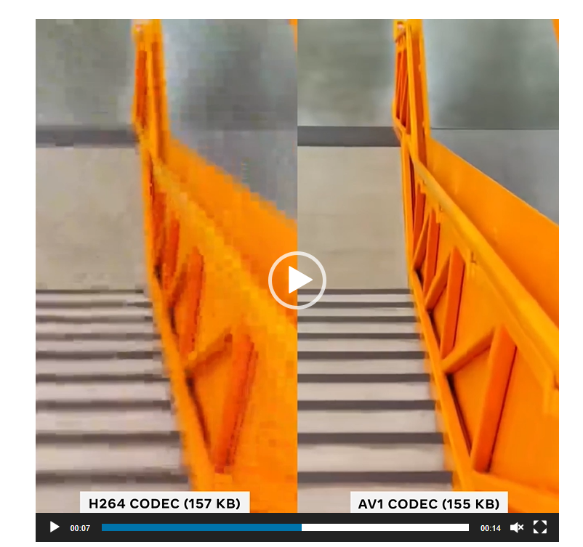
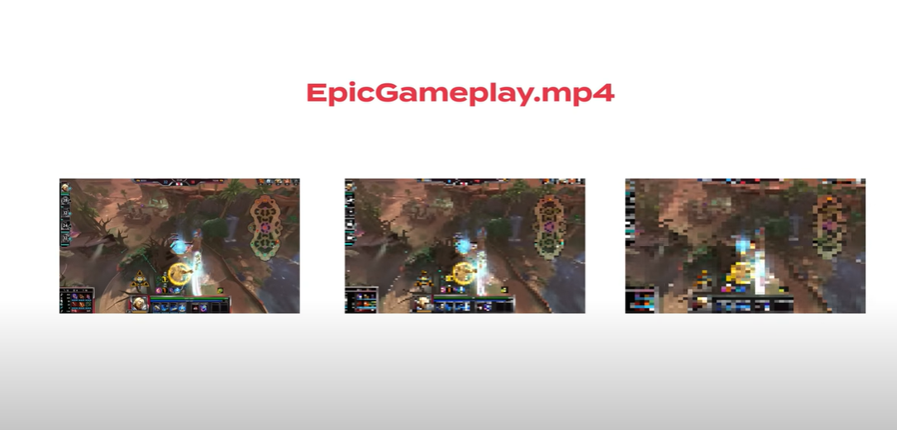
Where Instagram spends video compute
We generate two types of video encoding for each video uploaded to Instagram:
Minimum functionality encodings are compatible with all Instagram clients. Their lower-efficiency compression is easier for older devices to decode and play.
Advanced encodings use newer compression technologies for higher-quality playback. In the example below, close-ups of two video frames show that we can provide sharper detail with fewer bits (note the clarity of the video on the right compared with that on the left).

Slide 7
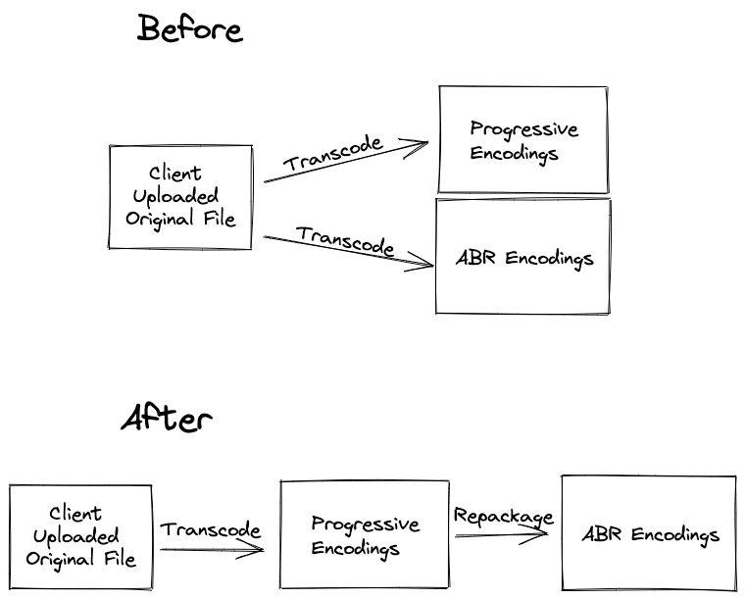
Adaptive Bitrate Streaming ECONDINGS AND PROGRESSEIVE ENCODINGS
$ time ffmpeg -i input.mp4 -vf scale=-1:720 -c:v libx264 output.mp4 86.17s user 1.32s system 964% cpu 9.069 total
$ time MP4Box -add input.mp4 -dash 2000 -profile dashavc264:onDemand -out manifest.mpd video_output.mp4 0.36s user 2.22s system 95% cpu 2.690 total

Slide 8
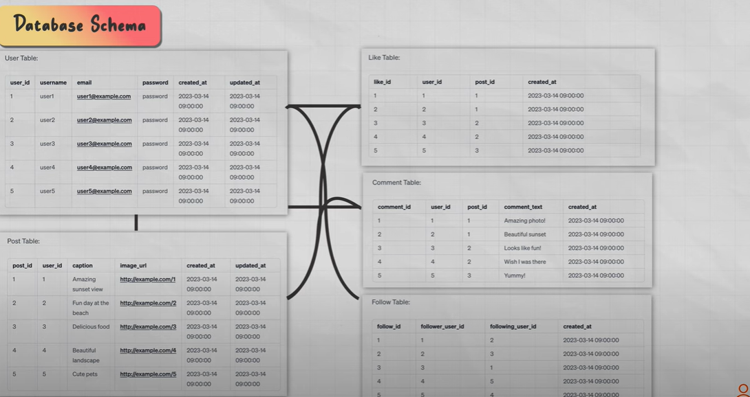
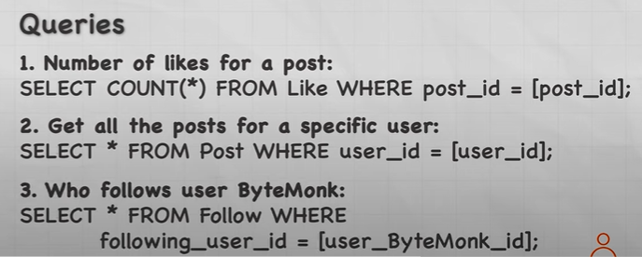

Slide 9
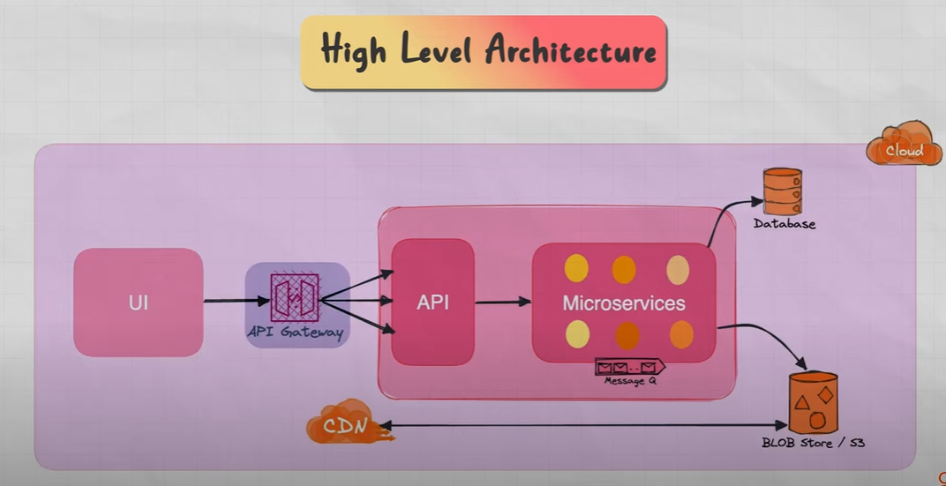
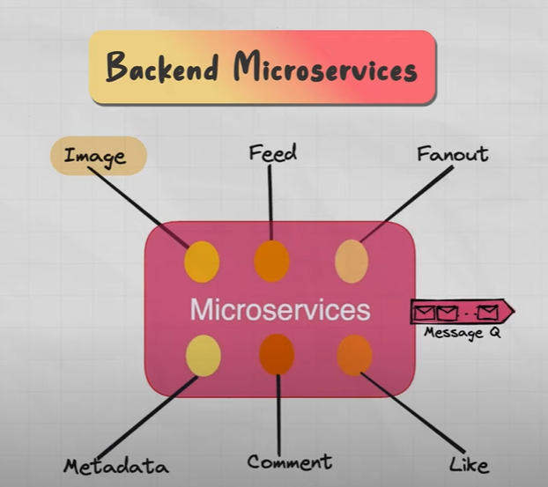
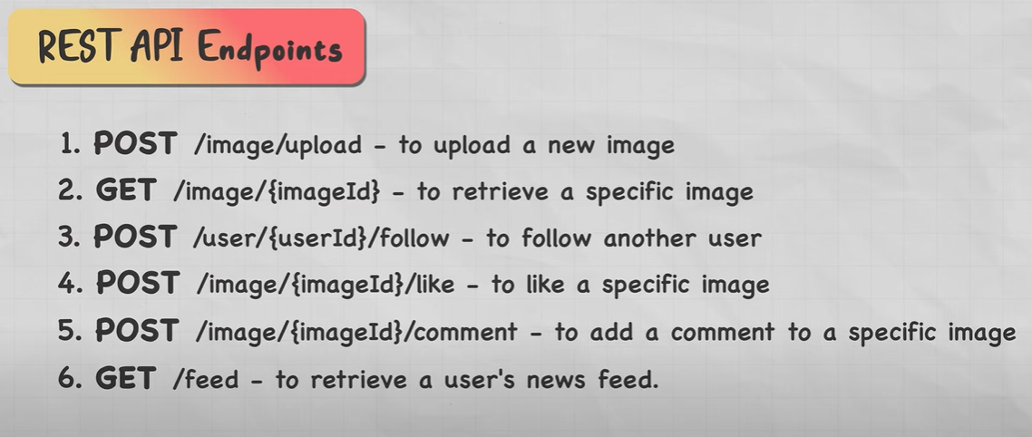

Slide 10
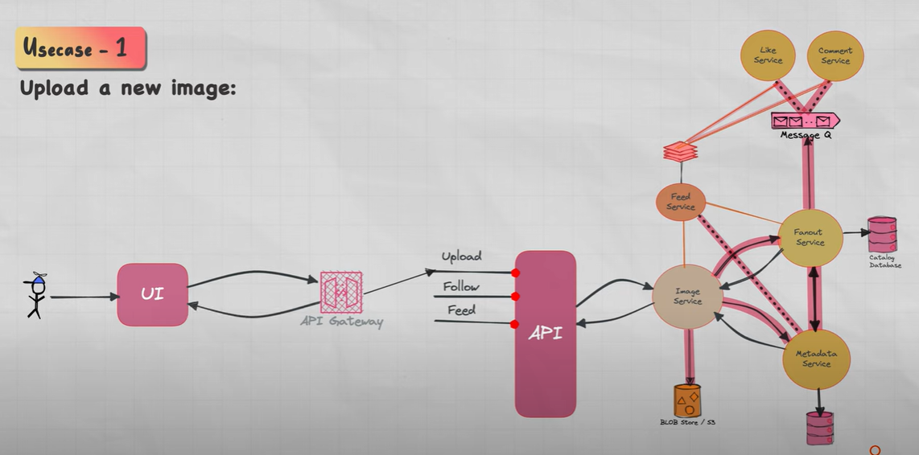

Slide 11
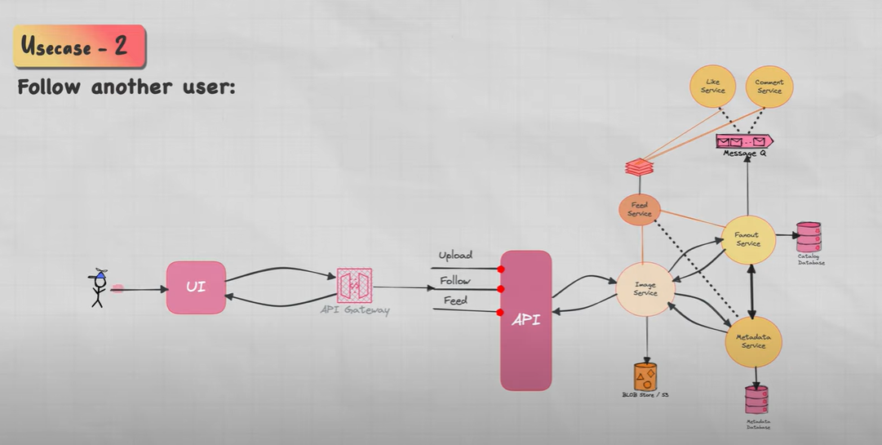

Slide 12
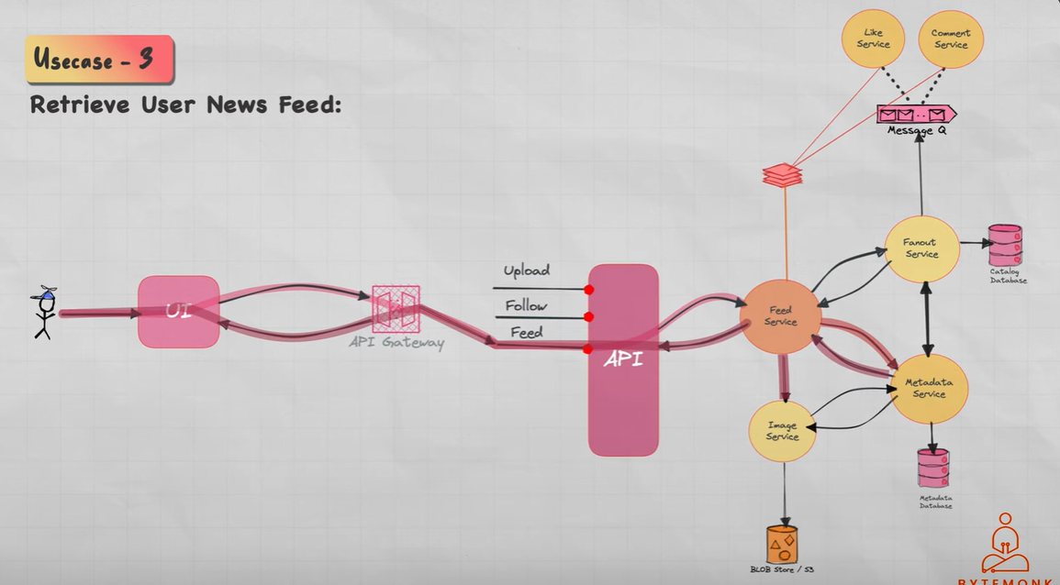

Slide 13
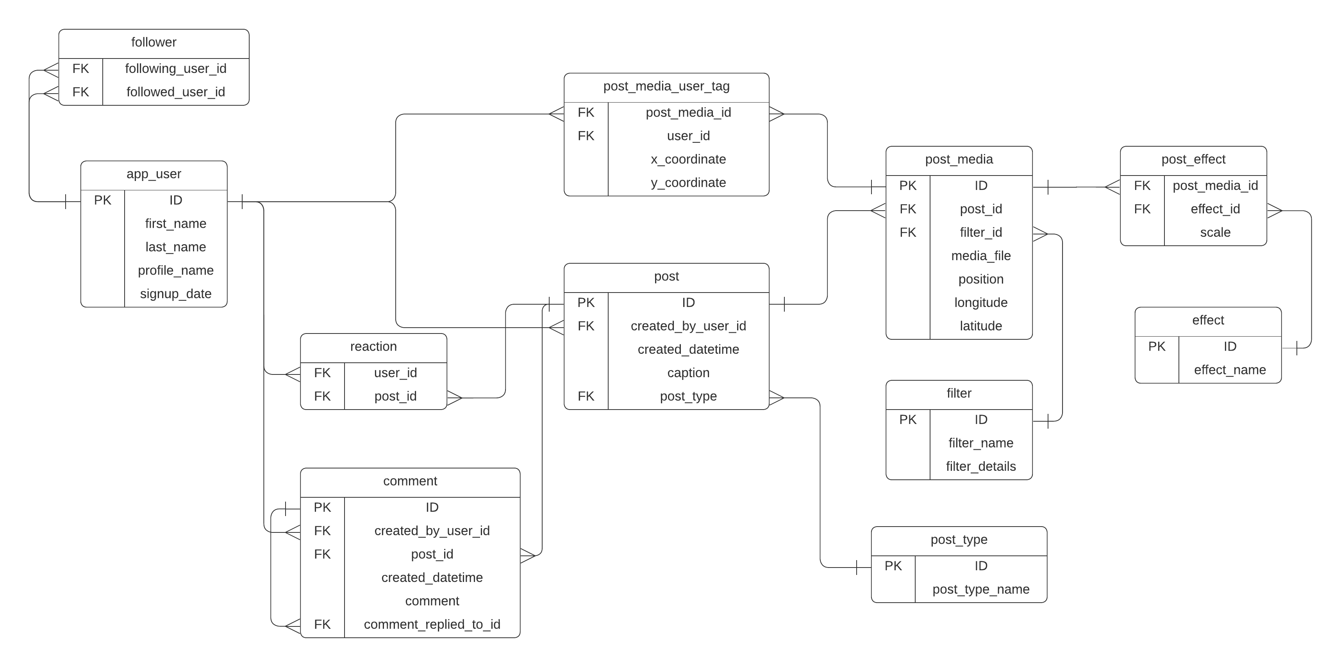

Slide 14

Thanks!
Do you have any questions? aliakbar786409@gmail.com
Infohubco.com

